Slide 1
Mediation
Gemma Wallace & Neil Yetz
PSY 653 Module 8 Lab
Apr 1, 2020

Slide 2
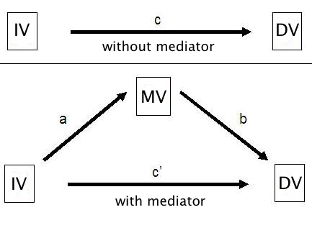
The “paths” in mediation

Slide 3
Baron & Kenny criteria for testing mediation
Show X is related to Y (c path)
Show X is related to M (a path)
Show Y is related to M (b path)
Show that M explains the relationship between X and Y (c’ path)
One way to do this is to show that controlling for M will cause r_{xy} to go toward zero
*Must meet all criteria to run a mediation model

Slide 4
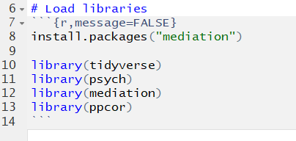
Load Libraries

Slide 5
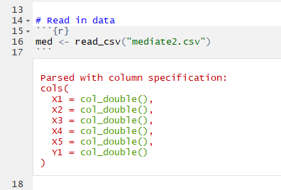
Read in data
This is a simulated dataset with four predictor variables (X1-X5) and one outcome variable (Y1)
Note: though not shown here, don’t forget to do your data management “best practices” by examining descriptives and visualizing data before conducting analyses!

Slide 6
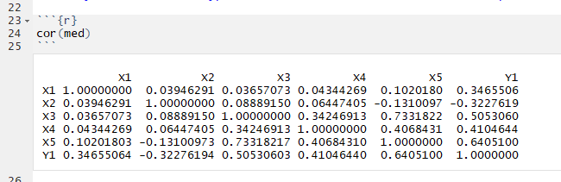
Examine correlations between variables

Slide 7
Analysis 1: Test the hypothesis that X4 mediates the relationship between X1 and Y1

Slide 8
Step 1: Determine if mediation is plausible, based on the Baron & Kenny Criteria
Examine correlations between variables
rxy = .3466 (c path)
rxm = .0434 (a path)
rmy = .4105 (b path)

Slide 9
Do we have justification to test the mediation hypothesis? (Baron & Kenny criteria)
rxy = .3466 (c path)
rxm = .0434 (a path)
rmy = .4105 (b path)

Slide 10
Do we have justification to test the mediation hypothesis? (Baron & Kenny criteria)
NO!
rxy = .3466 (c path)
rxm = .0434 (a path)
rmy = .4105 (b path)
Negligible correlation

Slide 11
Analysis 2: Test the hypothesis that X4 mediates the relationship between X3 and Y1

Slide 12
Step 1: Determine if mediation is plausible, based on the Baron & Kenny Criteria
rxy = .5053 (c path)
rxm = .3425 (a path)
rmy = .4105 (b path)

Slide 13
Do we have justification to test the mediation hypothesis? (Baron & Kenny criteria)
rxy = .5053 (c path)
rxm = .3425 (a path)
rmy = .4105 (b path)

Slide 14
Do we have justification to test the mediation hypothesis? (Baron & Kenny criteria)
YES!
rxy = .5053 (c path)
rxm = .3425 (a path)
rmy = .4105 (b path)
All paths have moderate correlations

Slide 15
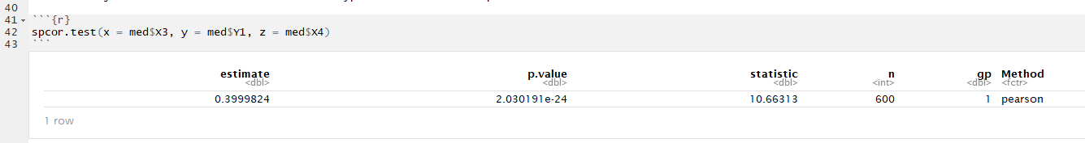
Step 2: Use semi-partial correlation to examine correlation between X and Y when partialling out the effect of the mediator
(Baron & Kenny Criteria, continued)

Slide 16
Step 2.1: Compare semi-partial correlation to rxy
(Baron & Kenny criteria)
Compare to rxy = .5053 (from previous slide)
r y(x.m) = 0.3999. This is 0.11 smaller than rxy (0.5053), indicating that partial mediation is plausible. In other words, there is a portion of the relation between x and y that involves m.

Slide 17
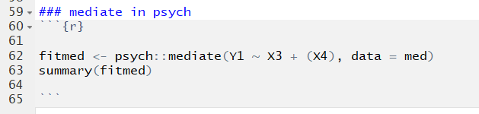
Step 4: Test mediation model via psych::mediate
psych::mediate: mediate function (via psych package)
Y1: Outcome variable
X3: Predictor variable
(X4): Mediator variable (keep it enclosed in parentheses)
data = med: dataset

Slide 18
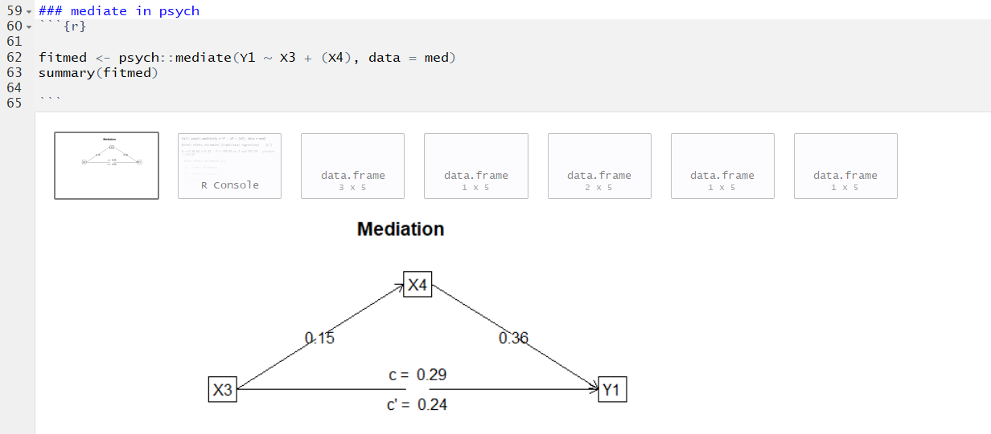
1
2
3
4
5
6
7
WINDOWS
Model diagram with paths
Function call
c’ path
c path
a path
b path
ab bootstrapped results (indirect effect)

Slide 19
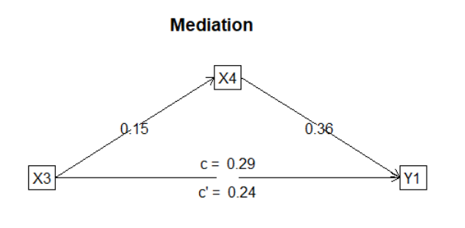
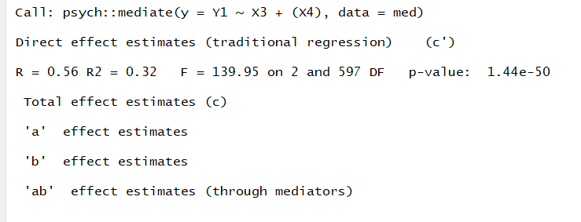
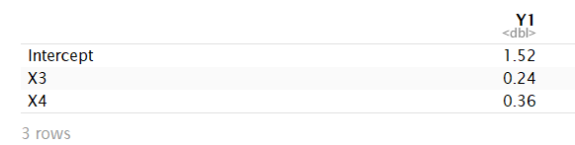
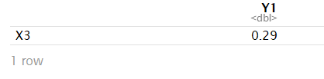
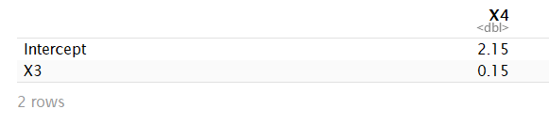
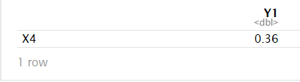
psych::mediate output windows
1: Diagram
2: Function Call
3: c’ path
4: c path
5: a path
6: b path
7: a*b path bootstrapped analysis (indirect effect)

Slide 20
psych::mediate output windows
1: Diagram
2: Function Call
3: c’ path
4: c path
5: a path
6: b path
7: a*b path bootstrapped analysis
(indirect effect)
Bootstrapped estimate
Evidence of partial mediation

Slide 21
psych::mediate a*b interpretation
To evaluate if the indirect effect is significant:
Output Window 7: a*b path bootstrapped analysis (indirect effect)
Does the bootstrapped confidence interval for the indirect effect (aka a path estimate * b path estimate) contain zero?
In this case it does not, indicating that X4 partially mediates the relation between X3 and Y1.
You can calculate the proportion of the relation of Y1 on X3 that is mediated by X4 by dividing the indirect effect by the total effect:
Proportion mediated = (a*b)/c
Proportion mediated = 0.05/0.29 = .1862. 18.6% of the effect is mediated.
Notes:
Make sure to talk about necessity of using boostrapped confidence intervals to evaluate significance of a*b (not p values!)

Slide 22
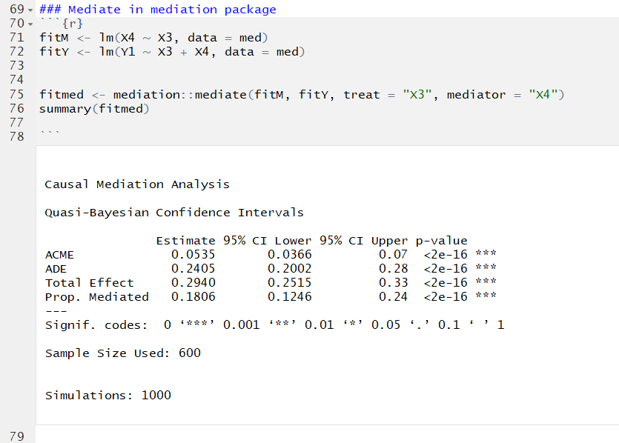
Step 5: Test mediation via mediation::mediate
Regress mediator variable (X4) on predictor variable (X3)
Regress outcome variable (Y1) on predictor (X3) and mediator (X4)
Use mediation::mediate to test models for mediation. Indicate predictor variable (treat = “X3”) and mediator variable (mediator = “X4”)
This is an alternative function() for testing mediation. Both work!

Slide 23
Step 5: Test mediation via mediation::mediate
ACME: “Average Causal Mediated Effect.” This is the effect of the mediator alone (ab bootstrapped; equivalent to window 7 via psych::mediate)
ADE: “Average Direct Effect” (c’ path; equivalent to window 3 via psych::mediate)
Total Effect: c path (equivalent to window 4 via psych::mediate)
Prop. Mediated: Proportion of variance explained by the mediator. (a path*b path)/c path

